Slide 1
Group 6:-Minimal Viable Product
By
Tyler Maregenetti, Jack E. Massey, Eva-Elena Bulai, Marta Velartova

Slide 2
Brief
Platformer
What Genre are we using?
What Mechanic are we changing?
What are we changing the mechanic into?
Control over the Player Character
Control over the levels.
What emotions are we looking for?
What are the Key Design problems we will face?
What are the Key Programming issues we will have?

Slide 3
Programming
The player can control parts of the level, but not the main character
This involves the player moving parts of the level to allow the main character to move forward, which costs “mana”

Slide 4
Gameplay
[Insert video here]

Slide 5
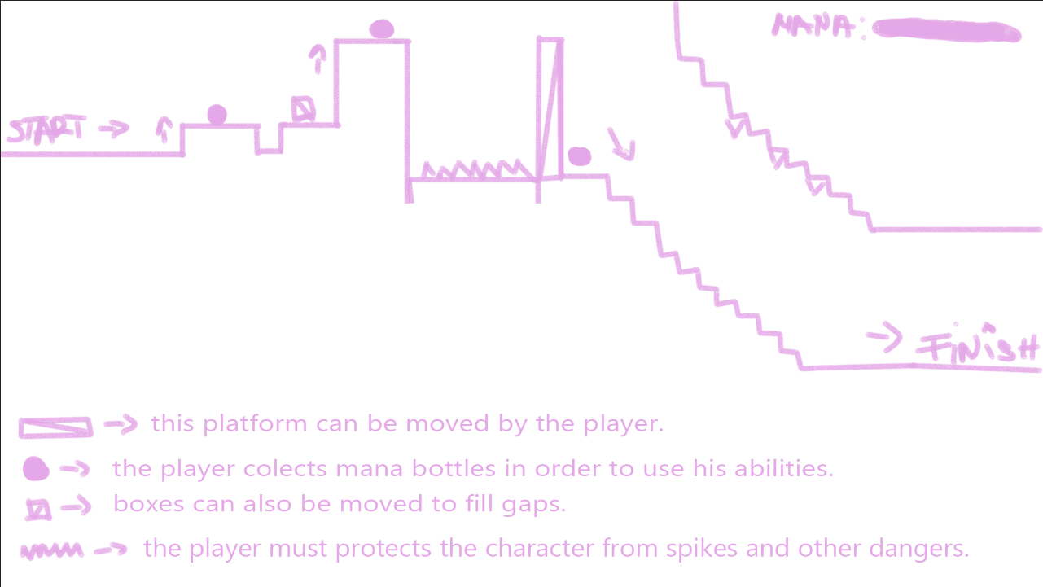
Level Design
The first level is built in such manner so the player can learn the controls and how the game works.
The difficulty slowly rises as the player runs for the finish line.

